Slide 1

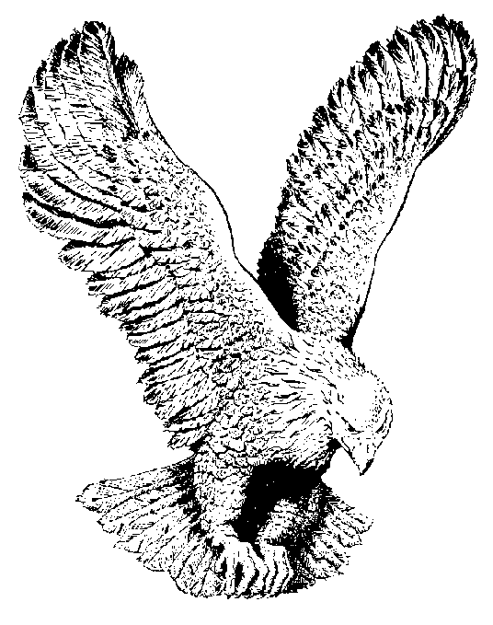
ARISE MY SOUL
Arise, my soul, arise!
Shake off thy guilty fears!
The bleeding sacrifice
In my behalf appears.
Before the throne my surety stands
My name is written on His hands.
My name is written on His hands.

Slide 2
He ever lives above
For me to intercede.
His all-redeeming love
His precious blood to plead.
His blood atoned for all our race
And sprinkles now the throne of grace.
And sprinkles now the throne of grace.

Slide 3
Five bleeding wounds He bears
Received on calvary.
They pour effectual prayers
They strongly plead for me.
“Forgive Him, O forgive”, they cry
“Nor let that ransomed sinner die”.
“Nor let that ransomed sinner die”.

Slide 4
The Father hears Him pray.
His dear anointed One
He cannot turn away
The presence of His Son!
His Spirit answers to the blood
And tells me I am born of God
And tells me I am born of God!

Slide 5
My God is reconciled
His pardoning voice I hear.
He owns me for His child
I can no longer fear.
With confidence I now draw nigh
And “Father, Abba Father” cry!
And “Father, Abba father” cry!

